Slide 1
Architectures in Context
Software Architecture
Lecture 2

Slide 2
Fundamental Understanding
Architecture is a set of principal design decisions about a software system
Three fundamental understandings of software architecture
  Every application has an architecture
  Every application has at least one architect
  Architecture is not a phase of development
Notes:
Architecture provide a frame of reference, a vocabulary, basis for describing properties, and a basis for effective analysis. New architecture can be created based upon experience with and improvement to pre-existing architecture.
It is not applicable in all cases, consider accession example of home, building and moon where each problem requires different pattern/architecture.

Slide 3
Design Decisions
Design decisions encompass every aspect of system under development
  System structure
  Functional behaviour
  Interaction
  Non-functional properties
  Implementation

Slide 4
Wrong View: Architecture as a Phase
  Treating architecture as a phase denies its foundational role in software development
  More than “high-level design”
  Architecture is also represented, e.g., by object code, source code, …
Notes:
Creating architecture of a system is not considered as a phase of software development because it is a fundamental activity that spans the entire software development lifecycle rather than being confined to a specific phase. Architectural decisions are not made once and for all, they evolve over time as the project progresses and new requirements emerges. Create an architecture involves collaboration among stakeholders, including architectures, developers, domain experts & end users. Architecture documentation serves as a communication tool that helps stakeholders understand the system’s structure, rationale behind design decisions and key considerations. It facilitates communication & collaboration among team members and enables future maintenance and evolution of the system.

Slide 5
Context of Software Architecture
Requirements
Design
Implementation
Analysis and Testing
Evolution
Development Process

Slide 6
Requirements Analysis
Traditional SE suggests requirements analysis should remain unsullied by any consideration for a design
However, without reference to existing architectures it becomes difficult to assess practicality, schedules, or costs
  In building architecture we talk about specific rooms…
  …rather than the abstract concept “means for providing shelter”
In engineering new products come from the observation of existing solution and their limitations
Notes:
Unsullied = Spotlessly clean and fresh

Slide 7
New Perspective on Requirements Analysis
Existing designs and architectures provide the solution vocabulary
Our understanding of what works now, and how it works, affects our wants and perceived needs
The insights from our experiences with existing systems
  helps us imagine what might work and
  enables us to assess development time and costs
→ Requirements analysis and consideration of design must be pursued at the same time

Slide 8
Non-Functional Properties (NFP)
NFPs are the result of architectural choices
NFP questions are raised as the result of architectural choices
Specification of NFP might require an architectural framework to even enable their statement
An architectural framework will be required for assessment of whether the properties are achievable

Slide 9
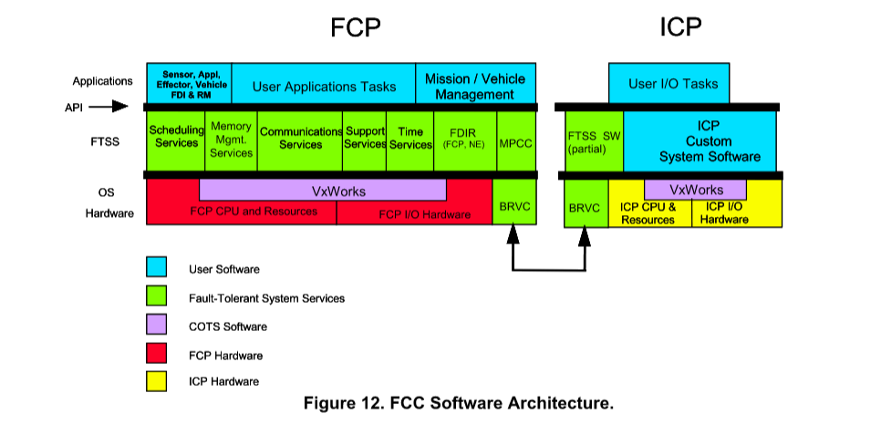
NASA’ Fault Tolerant System
Notes:
The central part of the avionics architecture of NASA&#39;s X-38 Crew Return Vehicle is a quad-
redundant Flight Critical Computer (FCC) which is based on Draper&#39;s Fault Tolerant Parallel
Processor (FTPP) architecture. The FCC consists of four Flight Critical Processors (FCPs)
operating as a quad-redundant Virtual Group (VG), five simplex Instrument Control Processors
(ICPs) running as five separate VGs, five Draper Network Elements (NEs), four Multi-
protocol/RS-422-cards, sixteen Digital I/O (DIO) cards, four Analog I/O cards, and four Decomm
cards.
The FCPs, operating as a single, quad-redundant set, function as the main application
processor. A complete suite of Fault Tolerant System Services (FTSS) software will be loaded
onto the FCPs and provide an Application Programming Interface (API) between NASA&#39;s
application code and the underlying hardware (Motorola Power PCs) and a COTS operating
system (VxWorks). The FTSS software provides Scheduling Services, Communication
Services, Time Services, Memory Management Services, Fault Detection and Isolation,
Redundancy Management, System Support Services, and a Mission Management template. A
reduced set of FTSS Communications Services will be loaded onto each ICP and will provide an
API between the I/O software running on the ICPs and the NEs.

Slide 10
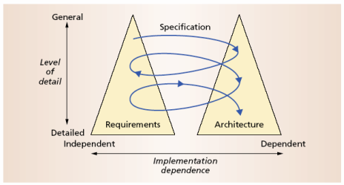
The Twin Peaks Model

Slide 11
Design and Architecture
Design is an activity that penetrates software development
It is an activity that creates part of a system’s architecture
Typically in the traditional Design Phase decisions concern
  A system’s structure
  Identification of its primary components
  Their interconnections
Architecture denotes the set of principal design decisions about a system
  That is more than just structure

Slide 12
Architecture-Centric Design
Traditional design phase suggests translating the requirements into algorithms, so a programmer can implement them
Architecture-centric design
  stakeholder issues
  decision about use of COTS component
  Architecture style and structure
  package and primary class structure
  deployment issues
  post implementation/deployment issues
Notes:
COTS = Commercial off the shelf components/ open source
Architecture centric design involves addressing stakeholder issues, making decision about using COTS, selecting or defining the architecture in such a way that tells what is the structure of the system, how the components are arranged and interacting/communication with each other. Defining how the software is divided into smaller, manageable units called package/module and how primary class (the main building block of software) are organized with these packages. Considering how the software will be installed on end-user system. Even after software is deployed, there may be ongoing issues that need to be addressed. This could include user feedback, bug fixes, updates and scaling the software to handle increased usage.

Slide 13
Design Techniques
Basic conceptual tools
  Separation of concerns
  Abstraction
  Modularity
Two illustrative widely adapted strategies
  Object-oriented design
  Domain-specific software architectures (DSSA)

Slide 14
Object-Oriented Design (OOD)
Objects
  Main abstraction entity in OOD
  Encapsulations of state with functions for accessing and manipulating that state
Notes:
state = data (data changes = state changes) = variable

Slide 15
Pros and Cons of OOD
Pros
  UML modeling notation
  Design patterns
Cons
  Provides only
    One level of encapsulation (the object)
    One notion of interface
    One type of explicit connector (procedure call)
  OO programming language might dictate important design decisions
  OOD assumes a shared address space
Notes:
One level of abstraction is not capable of providing sufficient granularity for managing complexity in larger systems.
One notion of interface may limit flexibility in designing systems with multiple interface with little variations.
Procedure calls may not be suitable for all types of interactions such as asynchronous communication, event-driven systems or distributed systems.
Different languages have different structure, way of handing mechanisms and their drawbacks which can limit the required functionality and forces for simulation.
OOD assumes shared address space where all objects reside in memory and communicate directly via method calls. This assumption may not hold in distributed environment or concurrent systems where all objects may need to communicate over network boundaries or in parallel execution contexts. Remote procedure calls (RPC) can resolve this issue at some extent.

Slide 16
DSSA – Domain Specific S/w Arch
Capturing and characterizing the best solutions and best practices from past projects within a domain
Production of new applications can focus on the points of novel variation
Reuse applicable parts of the architecture and implementation
Applicable for product lines
  →Recall the Philips example discussed in the previous lecture
Notes:
Domain specific architecture helps in reusability if organization is working in the same domain again and again and save lot of time by considering and refining existing architecture.

Slide 17
Implementation
The objective is to create machine-executable source code
  That code should be faithful to the architecture
    Alternatively, it may adapt the architecture
    How much adaptation is allowed?
    Architecturally-relevant vs. -unimportant adaptations
  It must fully develop all outstanding details of the application

Slide 18
Faithful Implementation
All of the structural elements found in the architecture are implemented in the source code
Source code must not utilize major new computational elements that have no corresponding elements in the architecture
Source code must not contain new connections between architectural elements that are not found in the architecture
Is this realistic?
Overly constraining?
What if we deviate from this?
Notes:
As the nation, so the buffalo!

Slide 19
Unfaithful Implementation
The implementation does have an architecture
  It is hidden, as opposed to what is documented.
Failure to recognize the distinction between planned and implemented architecture
  Deprives one of the ability to reason about the application’s architecture in the future
  misleads all stakeholders regarding what they believe they have as opposed to what they really have
  makes any development or evolution strategy that is based on the documented (but inaccurate) architecture destined to failure

Slide 20
Implementation Strategies
Generative techniques
  e.g. parser generators
Frameworks
  collections of source code with identified places where the engineer must “fill in the blanks”
Middleware
  CORBA, DCOM, RPC, …
Reuse-based techniques
  COTS, open-source, in-house
Writing all code manually
Notes:
Generative techniques: generate code based on high level specification. (Difficult to debug current & future problems)
Fill in the blanks = customize
Middleware: Communication and interactions b/w components in distributed environment like Common object request broker architecture, Distributed component object model, remote procedure calls. Middleware enables developers to focus on logic instead of low-level networking.

Slide 21
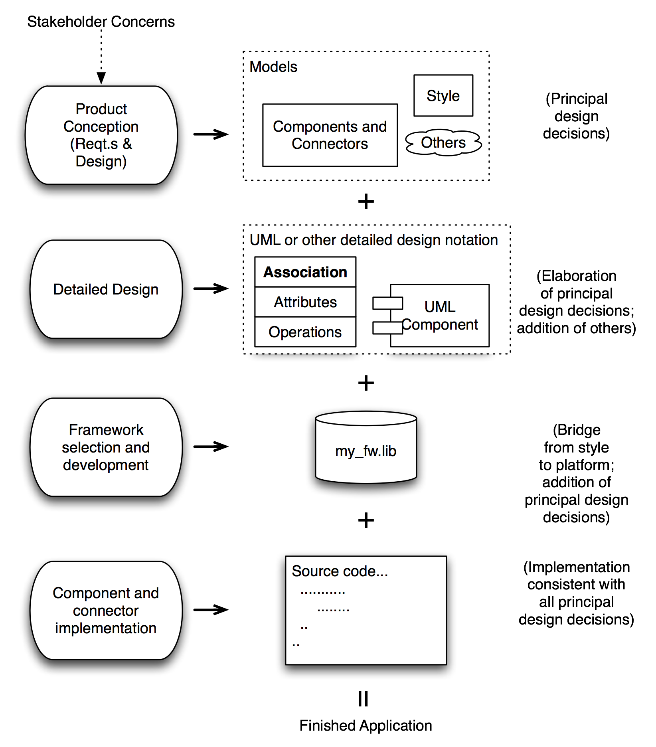
How It All
Fits
Together
Software Architecture: Foundations, Theory, and Practice; Richard N. Taylor, Nenad Medvidovic, and Eric M. Dashofy; © 2008 John Wiley & Sons, Inc. Reprinted with permission.

Slide 22
Analysis and Testing
Analysis and testing are activities undertaken to assess the qualities of an artifact
The earlier an error is detected and corrected the lower the aggregate cost
Rigorous representations are required for analysis, so precise questions can be asked and answered
Notes:
Rigorous = careful

Slide 23
Analysis of Architectural Models
Formal architectural model can be examined for internal consistency and correctness
An analysis on a formal model can reveal
  Component mismatch
  Incomplete specifications
  Undesired communication patterns
  Deadlocks
  Security flaws
It can be used for size and development time estimations

Slide 24
Analysis of Architectural Models (cont’d)
Architectural model
  may be examined for consistency with requirements
  may be used in determining analysis and testing strategies for source code
  may be used to check if an implementation is faithful

Slide 25
Evolution and Maintenance
All activities that chronologically follow the release of an application
Software will evolve
  Regardless of whether one is using an
  architecture-centric development process or not
The traditional software engineering approach to maintenance is largely ad hoc
  Risk of architectural decay and overall quality degradation
Architecture-centric approach
  Sustained focus on an explicit, substantive, modifiable, faithful architectural model

Slide 26
Architecture-Centric Evolution Process
Motivation
Evaluation or assessment
Design and choice of approach
Action
  includes preparation for the next round of adaptation

Slide 27
Processes
Traditional software process discussions make the process activities the focal point
In architecture-centric software engineering the product becomes the focal point
No single “right” software process for architecture-centric software engineering exists

Slide 28
Summary (1)
A proper view of software architecture affects every aspect of the classical software engineering activities
The requirements activity is a co-equal partner with design activities
The design activity is enriched by techniques that exploit knowledge gained in previous product developments
The implementation activity
  is centered on creating a faithful implementation of the architecture
  utilizes a variety of techniques to achieve this in a cost-effective manner

Slide 29
Summary (2)
Analysis and testing activities can be focused on and guided by the architecture
Evolution activities revolve around the product’s architecture.
An equal focus on process and product results from a proper understanding of the role of software architecture

